Slide 1



E X P E R T
A G I L E
C 0 A C H I N G
BY
S R I R A M

Slide 2
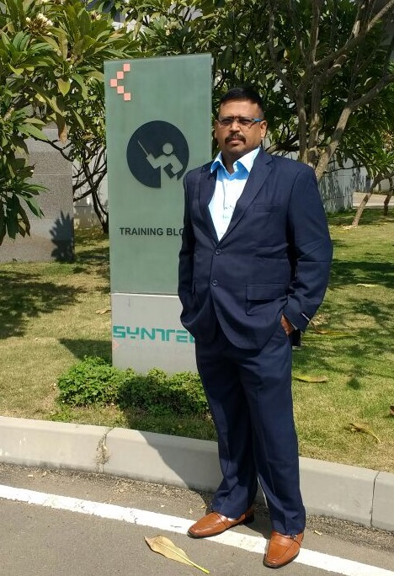


Preface
IC Agile Certified Professional – Agile Coaching (ICP-ACC)
SAFe Program Consultant (SPC4)
Certified Scrum Professional (CSP)
Project Management Professional (PMP)
Visit my website –
www.agilecoachmaster.wordpress.com
I have been involved in IT Software development since 1997. I have unique combination of process, technical and industrial skills. Currently working as an agile leader in US MNC. As a Certified Agile Coach, I have expert level of knowledge in agile and practices with this combination I can help process and technology people, understand the agile world.
My agile coach journey started in 2011, when I was a part of Tata Consultancy Services. I practiced XP, Scrum, Lean Kanban and agile methods thoroughly over several years and my teams are highly successful in delivering products using agile techniques.
I am proficient in agile engineering, coaching practices and SAFe consulting practices... Worked in India, USA, and UK for TCS, Syntel agile customers, which creates a global agile experience and awarded as a best coach.

Slide 3

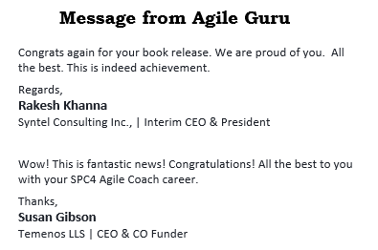
I have created agile websites and released books related to “Scrum Master Supreme Action Guide”, “PMI-ACP Ultra Supreme Action Guide”, ” Expert Agile Coaching”, “Agile A Key of Success”, “Handy Agile” & “ Leading SAFe 4.5 Supreme Action Guide”.
As a Senior Agile Coach helped to improve the teams of developers and overall project management by increasing collaboration, innovation, and introducing techniques that promote adaptability and flexibility in the face of unpredictable circumstances.

Slide 4

Table of Contents
Chapter 1 Getting Started with Agile Coaching
Chapter 2 Coaching Agreement
Chapter 3 Professional Coaching Skills
Chapter 4 Coaching Conversations – Coaching for Actions
Chapter 5 Understanding Team development
Chapter 6 Setting up the Team environment
Chapter 7 Review and Assessment of Agile Frameworks
Chapter 8 Mentoring Agile Roles & Transitions

Slide 5
Chapter 1.
Getting Started with
Agile Coaching
Learning Objectives
Define Coaching
Understand human motivation for change
Training vs Mentoring vs Coaching
Key mindset shifts
Coaching Competencies (ICF)
Understanding Human Motivation and Change
Agile Coaching Competency

Slide 6





What is Coaching?
Activity 1.1 : Roles and Responsibility of Agile Coach
Discuss on your table the role of an agile coach
What are the key sills / competencies of an agile coach
Identify the various responsibilities expected from an
agile coach
10
min

Slide 7
Activity
Solution: Activity 1.1 Roles & Responsibility of an Agile Coach
Role of an agile coach
Facilitator: Facilitate the team with the knowledge so that team can start the project.
Trainer: Provide training to the team on the agile process; training will continue all the time during the project execution on agile and continuous improvement on velocity, quality, processes etc.
Help in preparing the overall planning of the project that means he will work as a consultant. He will provide various ideas, suggestions, strategies.
Make sure that team is following agile processes in each sprint at user story level as per the Definition of Done (DoD); However this is the responsibility of the Process Check Master but if project does not have a role of process check master, this activity should be handled by the agile coach.
Help team to answer all the questions on the agile process during the project execution; that means agile coach need to be on the ground so that he can answer the questions immediately.
Identify project risks and raise them immediately
Make the winning strategy according to the ground conditions
Mentor: Focusing on people and Continuous Improvement all the time; provide team a platform for improvement not only during the retro but all the time. Create a safe environment for healthy conflict and meaningful collaboration.
Identify process issues and improve them
Help product owner to write user stories
Help team on the estimating of the user stories and prepare them for the same
Help scrum master to plan meetings like
preplanning, planning, daily scrum, Review & Retrospective
Provide capacity calculator template for the team
Provide the common tasking codes for the team for better tracking on technical front

Slide 8
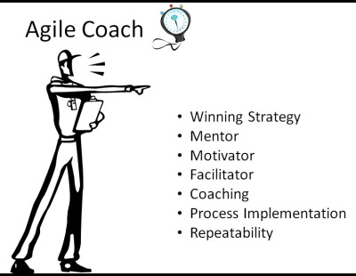
Activity
Solution: Activity 1.1 Responsibilities of an agile coach
Assist Agile teams in acquiring the necessary skills to rapidly become self-sufficient and benefit from Agile approaches. Define and manage project scope, goals and deliverables.
Support the start-up of projects, give advice to improve the application of Agile delivery methods (Kanban, Scrum, XP, etc.) throughout projects, and institute best practices.
Promote and facilitate the adoption of Agility within teams through team coaching, one-on-one mentoring, delivery of Agile training classes, workshops, and briefings.
Manages the coordination of activities among subordinates, customers, and third party vendors and subcontractors

Slide 9
Activity
Solution: Activity 1.1 Key Skills | Competencies of an agile coach
Must be a “Servant Leader” and able to garner respect from your teams and be willing to get your hands dirty to get the job done
Must be able to lead and demonstrate value-add principles to a team
Must be able to ensure Agile concepts and principles are adhered to, must be able to be a voice of reason and authority, make the tough calls. Must be able to provide objective guidance, without personal or political considerations.
Must be familiar with multiple Agile delivery methods including Kanban, Scrum, Extreme Programming, and Lean.
Must have situational awareness and be the first to notice differences and issues as they arise and elevate them as needed
Must have a ‘continual improvement’ mindset and be continually growing the craft, learning new tools and techniques
Must be an expert at conflict resolution and be able to facilitate discussions of alternatives/different approaches
Must be able to build trust relationships among and between teams by fostering disclosure and transparency to the development process.
Must possess excellent interpersonal skills and demonstrate the ability to work with diverse personality types.
Deep understanding of agile techniques, principles, processes and tools.
Possess facilitation skills in leading planning meetings, reviews, and retrospectives.
Possess strong analytical and problem solving skills with a high attention to detail.
Possess exceptional verbal and written communications skills, including the ability to represent technical subjects through concise, easy to understand graphics and text

Slide 10
Why Coaching?
Why do we need a coach at all?
What will a coach do that a manager does not?
Coaching is…
Facilitate positive change
Explore and enhance individual/team potential
Enable self-learning and self-growth

Slide 11







Coaching Definition
Coaching is partnering with clients in a thought- provoking and creative process that inspires them to maximize their personal and professional potential.
Source : coachfederation.org
Coaching is a form of development in which a person called a coach supports a learner or client in achieving a specific personal or professional goal.
Source : https://en.wikipedia.org/wiki/Coaching
How does Coaching enhance Potential?
Coach enables:
Self-learning
Self-growth
Coachee is the primary DOER!

Slide 12

Understanding Human Motivation
for Change
Why Worry about Change?
“Smooth sailing” is only temporary!
No matter how well positioned you may be right now, a disrupting change may be just around the corner.
Market dynamics
Client expectations
Technology
Competition

Slide 13




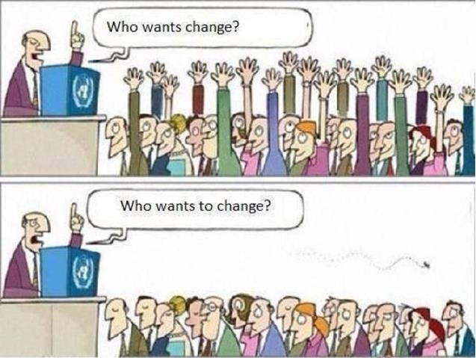
Activity
Activity 1.2 : What motivates people for Change?
Based on your experience, what do you think motivates people for change, and what discourages them from change?
Away from Change
Towards Change
10
min
Away from Change: Fear of failure, Comfort Zone, Lack of learning experience
Towards Change: Struck in Some thing, Breaking the Status Core
Do People Want to Change?

Slide 14


Thinking Fast & Slow
Our Subconscious mind:
➢Fast processing
➢Pattern-based, hardwires responses
➢Automatic perception
➢Energy efficient
Our Conscious mind:
➢Slow processing
➢Can make new patterns
➢Energy exhaustive
Change – The Bottom Line
Everyone derives some comfort in status quo
Everyone likes a little bit of change
People like change when it comes from within

Slide 15
The SCARF® Model
Common factors that activate a reward or threat response in social situations:
Status
Certainty Autonomy Relatedness
Fairness
The SCARF® Model
Status is about relative importance to others.
Certainty concerns being able to predict the future.
Autonomy provides a sense of control over events.
Relatedness is a sense of safety with others - of friend rather than foe.
Fairness is a perception of fair exchanges between people
There are also different behavioural and psychological consequences associated with threat and reward:

Slide 16
The SCARF® Model
Threat leads to:
- Reduced working memory, - Narrower field of view
- Generalising of threat, - Greater pessimism
Reward leads to:
- Greater cognitive resources. - More insights
- Increased ideas for action. - Fewer perceptual errors
- Wider field of view
-
See more at: http://www.brilliantminds.co.uk/news/the-scarf-model#sthash.sv6maKat.dpuf
How to enable Self-Learning and Self-Growth?
How to trigger new patterns in coachee’s mind?
Make them think
Engage their conscious mind
Asking powerful questions is the primary tool of a Coach!

Slide 17
What are Powerful Questions?
Questions that:
Generate insight in Coachee's mind
Motivate Coachee for action
Invoke commitment
Coaching vs Other Disciplines

Slide 18



Coaching is About…
Asking questions that lead the Coachee to the Solution!
Ask
Problem
Solution
Coaching vs. Other Disciplines
Ask
Counseling
Coaching
Problem
Solution
Consulting
Teaching/ Mentoring

Slide 19
Coaching is not Consulting
Consultant is a domain expert
Consultant does a job for you
Consultant provide facts, figures and reports
Consultant gives you expert advice
Coaching is not Training
The trainer provides specialized knowledge
Trainer follows a standard agenda and curriculum
The standard agenda is driven by the trainer
Training provides similar experience for each trainee

Slide 20

Coaching is not Mentoring
Mentoring is showing how something is done
Mentor needs to be subject matter expert
Mentor has relevant experience
Mentoring requires a close working relationship
Hand-holding and close observation during learning
Coaching has more structure than mentoring
Activity 1.3 : Mapping Needs with a Discipline
Map the following solution needs with a discipline:
Imparting knowledge based on a standard agenda
Helping a person figure the root cause of a serious behavioral
issue
10
min
Seeking external help to understand a complex technical problem the team has been facing for past several weeks
Helping someone learn how to develop a complex technical skill
Helping someone think through a nagging problem and figure a possible solution
Helping a group navigate through a problem and find a solution through consensus

Slide 21
Activity 1.3 : Mapping Needs with a Discipline
Activity
Solution: Activity 1.3 Mapping needs a discipline
Map the following solution needs with a discipline:
Imparting knowledge based on a standard agenda - Training
Helping a person figure the root cause of a serious behavioral issue - Counselling
Seeking external help to understand a complex technical problem the team has been facing for past several weeks - Counselling
Helping someone learn how to develop a complex technical skill – Mentoring
Helping someone think through a nagging problem and figure a possible solution – Coaching
Helping a group navigate through a problem and find a solution through consensus - Facilitating
Difference between Counselling | Consulting | Mentoring?
The difference between Counselling , Consulting & Mentoring are:-
Counselling – Idea to understand the problem (Traditional Counselling)
Consulting – Look at what going Wrong
Mentoring – Providing Solutions

Slide 22
Agile Coaching – Key Mindset Shifts
Coach as Role Model
Be a living example of the depth and usefulness of agile values
Being agile more than doing agile
Exhibit the ‘Ri’ stage of Agile
Would you hire a fitness trainer who needs to shed at least 10 kilos himself?
How would you feel if you find your child’s teacher verbally abusing someone on the road?

Slide 23
Servant Leadership
The term coined by Robert K. Greenleaf:
Lead by serving others
Provide leadership in helping others achieve their goals:
Focus on building capacity in others
Facilitate decision making process
Distance from the center of action and attention
Listen and give space
Cultivate Growth Mindset
Facilitate Learning goals
Mastery and Competence
Metrics reflect current state (NOW)
Measuring potential or productivity is a lower priority
Focus on positive emotion – Performance and Enjoyment
Decrease negative emotion

Slide 24
Activity
Activity 1.4 : Key Mindset Shifts
Review the list of responsibilities as a group and segregate them into two groups:
“Away From” – the responsibilities a Coach should move away from
“Towards” – the responsibilities a Coach should move towards
10
min
Solution: Activity 1.4 Key Mindset Shifts
”Away From” – the responsibilities a Coach should move away from (Ends with !!)
Create detailed work plan for the team!! Work with the customer and create a product vision!! Work with the Dev team in solving their technical programs!! Define performance expectations from team members!! Identity metrics to track team performance!! Focus on team productivity targets set by the management!! Track individual performance and report it to the management!!

Slide 25
Activity
”Away From” – the responsibilities a Coach should move away from (Ends with !!)
Resole organizational level impediments!! Help team members find the root cause of their problems!! Identify and resolve team conflicts!! Guide team members with specific instructions!! Evaluate Agile Frameworks and finalize the best fit for the team !! Focus on Scope, Schedule and budget targets!! Own Service delivery – ensure team delivers on time!!
Activity 1.4 : Key Mindset Shifts
”Towards” – the responsibilities a Coach should move towards (Ends with !)
Motivate team members towards higher performance! Identity and handle resistance from individuals! Teach Prioritization techniques to product owner! Facilitate teams in creating their ground rules! Continuously challenge the team to improve! Facilitate team in managing their own conflict! Identify team Dysfunction patterns and work on then! Educate Stakeholders on Agile Mindset!

Slide 26
Activity
”Towards” – the responsibilities a Coach should move towards (Ends with !)
Focus on overall team improvement! Facilitate team in creating their culture & vision! Focus on maximizing business value delivery! Engage with management to strategize agile transformation! Educate team about mindset and core practices! Facilitate decision making process! Facilitate team in finding their own solutions! Develop Self-organizing teams! Perform powerful conversations with Team and Leadership!
Activity 1.4 : Key Mindset Shifts
Coaching Competencies

Slide 27

Activity
Activity 1.5 : Professional Coaching Competencies
List key Skills and Competencies needed to perform the Coaching role in an effective manner
[Optional] Map these competencies with the list of key Coach responsibilities identified in the previous activity
15
min
Solution: Activity 1.5 Professional Coaching Competencies
List key Skills and Competencies needed to perform the Coaching role in an effective manner
1. Meeting Ethical Guidelines and Professional Standards
2. Establishing Trust the Coaching Agreement & Establish Trust and Intimacy with the Client
3. Active Listening
4. Powerful Questioning
5. Creating Awareness
6. Managing Progress and Accountability

Slide 28
ICF Coaching Competencies
Coaching is about behavioural competencies:
Setting the Foundation
Meeting Ethical Guidelines and Professional Standards
Establishing the Coaching Agreement
Co-creating the Relationship
Establishing Trust and Intimacy with the Client
Coaching Presence
ICF Coaching Competencies…
Communicating Effectively
Active Listening
Powerful Questioning
Direct Communication
Facilitating Learning and Results
Creating Awareness
Designing Actions
Planning and Goal Setting
Managing Progress and Accountability

Slide 29
The Agile Coach : Role and Responsibilities
Teaching – Instructing others in specific knowledge, skills and perspective Mentoring – Sharing knowledge, skills & perspective that foster the personal and professional growth of someone else Facilitating – A neutral process holder who guides groups through processes that help them come to solutions and make decisions Coaching – Partnering with clients in a creative process that inspires their personal and professional potential
Technical Mastery – Technical expertise as a software craft-person Business Mastery – Expert at business value driven innovation and product development Transformation Mastery – Expertise as an organizational development and change catalyst

Slide 30
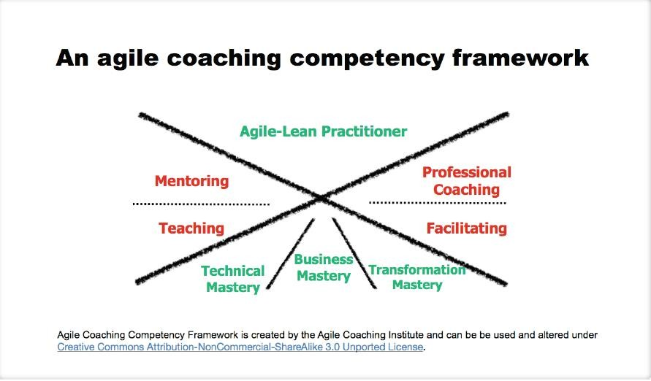
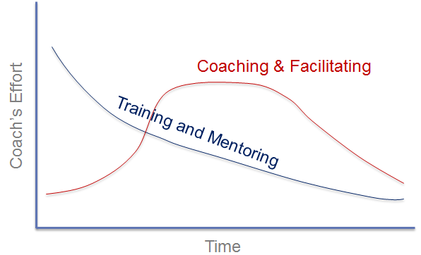
Roles and Responsibilities – Coach’s Journey

Slide 31
Agile Team
Agile Team Members
TO improve the effectiveness of the customer and users of the product and maximize the value of the organization AS AN Agile Team WE NEED to leverage the strengths of each team member and create valuable products now and in the future

Slide 32
Agile Team Members
Agile Team Member – Strives to be better than they were yesterday every day. Everyone in an Agile Team is first and foremost an Agile Team Member
Agile Customer – Ensures the team works on stories that deliver the highest business value possible
Agile Customer Proxy – Helps the Agile Customer ensure the team works on stories that deliver the highest business value possible
Agile Team Lead – Does whatever it takes to ensure the team delivers now and in the future
Agile Project Manager – Does whatever it takes to ensure that valuable projects are delivered now and in the future
Agile Business Analyst – Helps the Agile Customer discover the goals and needs of the customer of the product
Agile User Experience (UX) Designer – Helps the Agile Customer discover usability needs, help the team meet them and verify they have been met
Agile Developer – Implements stories with high business value using good techniques and practices.
Agile Architect – Ensures the team implements good techniques and practices
Agile Tester – Provides information on the state of the project.

Slide 33
Agile Team Members
Agile Coach – Creates a team that delivers value now and in the future
As an Agile coach, your goal is to develop productive agile teams that think for themselves rather than relying on you to lay down the path for them. You need to help them understand the agile from the value point of view rather than practice point of view.
You need to help them change the way of work, communicate, collaborate, understand the team based value delivery. During this process you need to help them unclearing some of their old habits, using your coaching skills, tools and techniques.
You need to understand, each team is different as they have different levels of skills, attitude, knowledge. That means your coaching strategy depends on what the teams need for you.
Agile Coaching Competencies

Slide 34
Activity
Solution: Activity 1.6 Agile Coach Competencies
Based on your learning so far, prioritize Coaching skills and competencies (top 5).
For each of the prioritized competency, perform a self assessment of your current competency level.
1. Meeting Ethical Guidelines and Professional Standards
2. Establishing Trust the Coaching Agreement
3. Active Listening & Creating Awareness
4. Powerful Questioning
5. Managing Progress and Accountability
Activity 1.6 : Agile Coach Competencies
This is an individual exercise.
Based on your learning so far, prioritize Coaching skills and competencies (top 5).
For each of the prioritized competency, perform a self assessment of your current competency level.
10
min

Slide 35

2/3/2017
You have successfully completed –
Getting Started with Agile Coaching
Chapter 2. Coaching Agreement

Slide 36
Learning Objectives
Coaching Stance
Internal vs. external coaches
Defining the coaching “contract”
Designing a coaching alliance
Coaching Stance
The Coaching discipline:
Holding the client’s agenda
Maintaining neutrality
Reducing client dependence
No colluding
Self awareness and self-management
Signature Presence

Slide 37

Internal vs. external coaches
Activity 2.1 : Discuss Internal and External Coaching
This is a class discussion exercise.
➢Discuss and identify challenges faced by:
Internal coaches
External coaches
15
min

Slide 38
Activity
Internal Coaches : Challenges
Too much pressure in influencing
Senior Management members has to collaborate
Taken for granted
Solution: Activity 2.1 Discuss Internal & External Coaching
External Coach : Challenges
Initially they don’t know about organization culture
Understanding Landscape
Take time to get respect

Slide 39
Internal Coaches : Challenges
Maintaining neutrality and confidentiality
Holding people accountable
Challenging the status quo
Personal bias
Difficult to stay out of office politics
External Coach : Challenges
Need for effective system entry
Treating the client process with respect
Balancing challenge and pace of change
Understanding organization culture is a slow process
Fostering too many new relationships

Slide 40

Coaching Contract
Activity 2.2 : Sample Agreement Review
➢Read the sample Coaching Agreement
➢Discuss the coaching agreement within your group
15
min

Slide 41
Activity
Solution: Activity 2.2 Coaching Agreement
Between ___________________________________ (Coachee)
and ____________________________________ (Coach)
In undertaking to coach you I am committing myself to be available at the time(s) we agree on and to provide a trusting, confidential relationship for you to explore issues and difficulties and move towards change. I will endeavor to support you in this process.
In undertaking to receive coaching from me you are committing yourself to be open and honest and to optimize the use of the coaching time. Your intent to grow in excellence and develop is a key ingredient in a successful coaching experience.
To be coachable, you must ensure that:
Your intent to change and desire for change are serious.
You are willing to try new ways of learning, be truthful, keep your commitments and inform your coach immediately when things are not working for you.
You are willing to explore, challenge and change thoughts, feelings and actions if you feel it will be beneficial for you.
You understand that your coach will be focused on you, your goals and your best interests. Your coach will be non-directive and non-judgmental.
Confidentiality
The coaching service is confidential between the coach and the Coachee except in the following instances:
It has been agreed in advance that the progress of the sessions will be discussed with senior management.
If the Coachee gives information to the coach for the purpose of discussion with others.
If the Coachee gives information to the coach that may be linked with possible physical harm to the Coachee or others.
Cancellations
If you wish to change the time of a session the coach should be informed in writing as soon as possible and a minimum of three working days before the scheduled session. The full coaching fee will be charged for changes made less than three days in advance.

Slide 42
Activity
Duration and Termination
The initial coaching agreement is for: _________________________ Term ( 1 Year)
Towards the end of these sessions there will be a discussion regarding progression and next steps. Termination of coaching engagement must be in writing and agreed before the final coaching session to allow time for closure.
Coachee Records
Any written notes taken by the coach are securely kept and are confidential.
I have read and understood this agreement.
Name: ______________________________________ (Coach)
Signature: ___________________________________________
Date: _______________________________________________
Name: ______________________________________ (Coachee)
Signature: __________________________________________
Date: ______________________________________________

Slide 43
Before you Begin: Important Considerations
What are the overall goals for coaching? Are there specific performance- related goals or expectations?
What are the coachees’ attitude towards coaching?
What are the reporting and confidentiality boundaries and are these clearly understood by the coach and the coachee?
What is the contracted time for coaching? Will it be a continuous or intermittent engagement?
If intermittent, how often is coaching expected and how long will each session be?
Has the coachee allocated time for coaching – both for sessions and follow-up actions?
Have the coach and coachee established a good rapport?
How and when will the coaching be reviewed?
How will the impact of coaching be measured?
Agile Coaching Specific Points
Is Agile training part of the engagement?
How often will the agile training will be conducted?
How long will each session be?
How many locations will be covered in coaching?
How many teams are part of it?
Will coaching involve working with Scrum Masters and/or the entire team?

Slide 44
What a Coach Must Not do?
Manage teams or team members
Give performance evaluations for team members
Track Delivery issues
Work with clients in contract negotiations
Coaching Prerequisites - The Bottom Line
Purpose
Does the coachee/team have a clear goals that focus on delivering business value?
Commitment
Is the coachee/team committed to achieve their goal?
Motivation
Is the coachee/team motivated to work with the Coach?
Expectations
Does the client/coachee have realistic expectations from the Coach?
Investment
Is the client/coachee/team ready to invest time, money and energy in the coaching process?

Slide 45
You have successfully completed –
Coaching Agreement
Chapter 3.
Professional Coaching Skills

Slide 46
Learning Objectives
Coaching Presence
Active Listening
Direct Communication
Powerful questioning
Giving and receiving feedback
Emotional intelligence
Coaching Presence

Slide 47




Coaching Presence
“Ability to be fully conscious and create spontaneous relationship with the coachee
by employing a style that is open, flexible and confident.”
- ICF
Coaching Presence – Key Motivations
Build rapport with the coachee
Engage coachee in the coaching process
Keep the coachee in ‘towards’ state

Slide 48
Coaching Presence – Key Behaviors
Be present and flexible
Use Humor effectively to create lightness and energy
Trust your intuition, the inner knowing
Be open to not knowing
“I don’t know what I don’t know”
Be open to change, stay flexible to new alternatives
Confidently experiment with new possibilities
Learn to work with strong emotions, without getting overpowered by them
Blocks to Coaching Presence
A self-focused approach:
Thinking too much about the next step
Trying too hard to get it right
Trying to push your own agenda
High emotional involvement:
Being judgmental of yourself or the coachee
Getting stuck in detail, problem or drama
Getting stuck in a filter

Slide 49

Active Listening
Activity 3.1 – Active Listening Sail boat
Identify circumstances and behaviours that:
Help in Active Listening
Discourage/compromise Active Listening
10
min

Slide 50
Activity
Solution: Activity 3.1 Active Listening Sail Boat
Team 1
Positive
Maintain Positive Body Language | Open Mindedness | Being interested ,motivated | Asking Question (Probing) | Taking Notes | Keeping Emotion
Challenges
Pre Conceived Notion | Subconscious Reactions |Loss of eye contact | Not being present in the moment | Pride or ego | Lack of respect
Team 2
Positive
Acknowledge Passphrase / Summarize Holding | Attitude (Optimism) | High Level Interest | Sense of need | Motivated Benefit so involved
Challenges
Noise | Communication Gap | Language Barrier | Cultural Context Lack of focus or Inattentive | Lack of context | Appropriateness | Out of Context | Lack of Support / Team mgmt. / Client
Team 3
Positive
Knowledge | Respect Mutual | Interactive Conversation | Collocated Team | Presentation Style | Listen to understand | Subject which interest everybody | Common interest or like minded
Challenges
Big Conversation without context | Distributed Team | Listen to reply

Slide 51




Active Listening
“Ability to focus completely on
what the client is saying and is not saying, to understand the meaning of what is said in the context of client’s desires, and
to support client’s self-expression.”
- ICF
Active Listening Approach
Attend to the client’s agenda
Listen to client at all levels
words, tone of voice and the body language
feelings, perceptions, concerns, values and beliefs
concerns, goals, ideas, suggestions
Help the client get there
Focus on the essence of client's communication
Allow the client to vent without judgment or attachment, bypass long and descriptive stories
Mirror back what client has said – summarize, paraphrase, reiterate
Integrate and build on client's ideas and suggestions

Slide 52
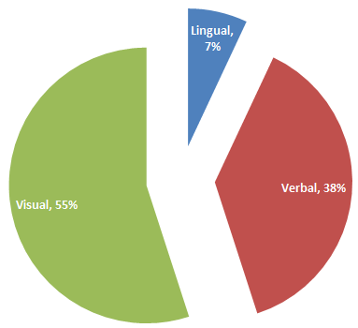
Components of Communication
Textual/ Lingual – Words of the language
Verbal/ Vocal – Tone, rhythm, pitch, pace
Visual - Body language, facial expressions, eye contact
Listen for Potential
Listen Generously
Listen without judgment
Listen at all Levels
Listen to words
Listen to emotion
Listen to body language
Listen for clarity and value
Listen intently
Listen with empathy
Listen without interfering
Listen without assumptions

Slide 53
Clarity of distance
Things to avoid while listening for potential:
Lost in the Details
Misled by our Filters
Having a personal Agenda
Hot Spots
Direct Communication

Slide 54

Direct Communication
“Ability to communicate effectively during coaching sessions, and to use language that has the
greatest positive impact on the client.”
- ICF
Direct Communication
Clearly state coaching objectives and agenda
Speak with intent
Be clear, articulate and direct in sharing and providing feedback
Reframe and articulate
Help the client understand from another perspective
Use appropriate and respectful language
non-sexist, non-racist, non-technical, non-jargon
Use metaphor and analogy

Slide 55
Speak with Intent
Succinct
Saves significant time and mental energy
Helps stay on client’s agenda
Use active visual words where necessary
Specific
Focus on meaningful and relevant information, beyond the obvious
One to three most important items
Generous
Help them relate to what you are saying
Use words to include other person’s perspective
Example – Being Succinct
We’re having a big meeting next Monday about our targets, we want to decide if we’re going to reach them or not. Richard is coming in to present the report from last quarter on sales compared to actuals from last year, it’s important to see where we are in comparison. We need to take a look at the two years carefully and see what the difference is, if the sales we’re doing this quarter are much different from last year, and in what way they are different. It will be useful to do some comparisons, check out all the variables and define exactly what’s changed and what’s stayed the same.

Slide 56
Example – Being Succinct…
We’re having a big meeting next Monday
to carefully review how we are doing this quarter compared to last year.
It’s an important meeting, so make sure you prepare thoroughly for it.
Other Communication Skills
Silence
Simple acknowledgements
Matching coachee’s energy
Matching coachee’s language

Slide 57
Powerful Questioning
Activity 3.2 – Powerful Questioning
This is an individual exercise.
You are an Agile Coach for multiple agile teams. One Scrum Master approaches you for help – he is feeling frustrated that he
is unable to conduct daily scrum within 15 minutes.
List some questions you would like to ask him to begin the coaching conversation.
10
min
Total Score (out of 40) -----------------
Higher Score indicates more performing team

Slide 58
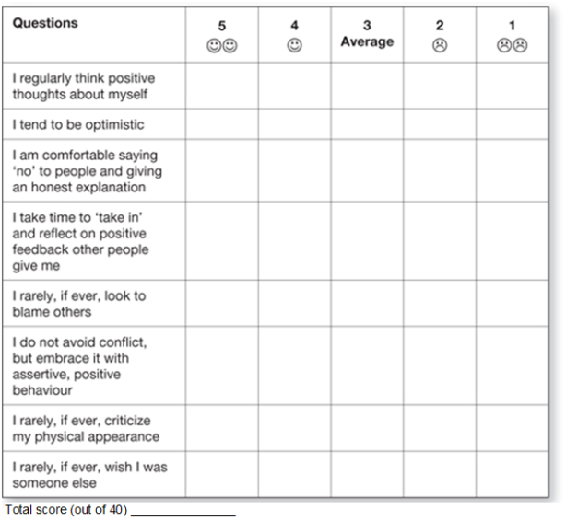
Activity
Solution: Activity 3.2 Powerful Questioning
Self Management

Slide 59
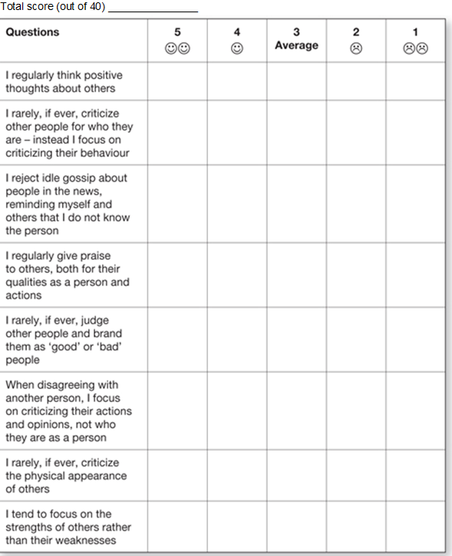
Activity
Social Management

Slide 60
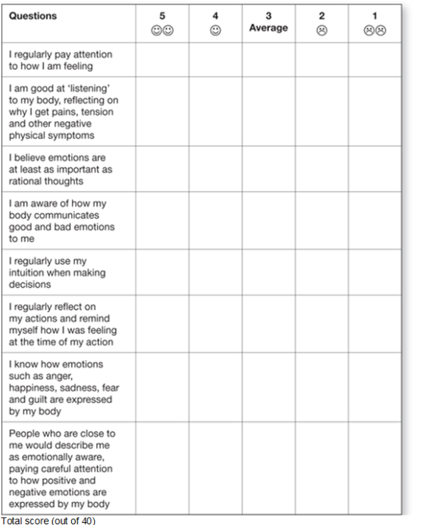
Activity
Self Awareness

Slide 61
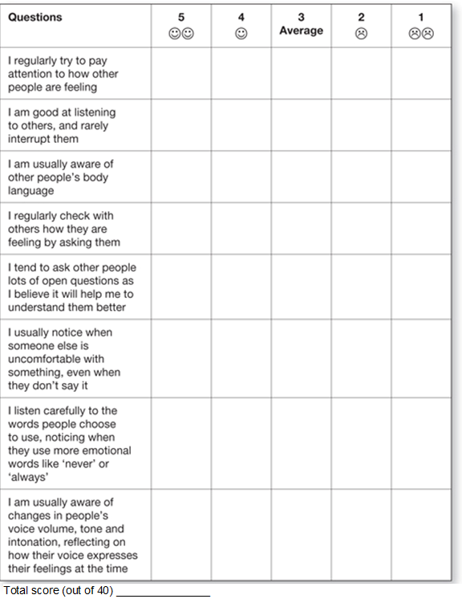
Activity
Awareness of Others

Slide 62



Powerful Questioning
“Ability to ask questions that reveal the information needed for maximum benefit to
the coaching relationship and the client.”
- ICF
Powerful Questioning
Asks questions that reflect active listening
Reflect understanding of the client's perspective
Challenge client's assumptions
Asks open-ended questions that evoke greater clarity:
Facilitate new insight, discovery or possibility
Prompt commitment to action
Asks questions that move the client forward:
Towards goals that they desire
Not backwards to problems and justifications

Slide 63


Choose your Focus
Don’t just set Action
Results
Behaviors
Focus on
Thinking
Feeling
Thinking
Choose your focus
Vision
Planning
Detail Problem
Drama

Slide 64
Questions less likely to Generate Insight
“Why” questions that try to get more details
Loaded questions that tell people what to think about
Questions that force people into action
Questions too focused on investigating the problem
Questions less likely to generate Insight…
Type | Example
Forcing people into action | What is your next step… What are you doing about…
Telling people how to think | Why don’t you think about… What about being more positive...
Asking “why” questions to get more details | Why is this issue… Why did you... Why don’t you…

Slide 65
Questions less likely to generate Insight…
Type | Example
Giving Advice | Why don’t you… What about doing this…
Asking questions about the problem | What is the issue… What is stopping you… Why do you think this…
Asking questions to get more details | Can you list…. What’s been happening …
Question that Generate Insight
Type | Example
Thinking Questions | How long have you been thinking about… What are your insights so far? What ideas have crossed your mind about…
Vision questions | What would you like to achieve here? What is your objective, goal or desired outcome?
Planning Questions | What are the milestones for achieving this goal? What are your options?

Slide 66
Question that Generate Insight…
Type | Example
Action Questions | What are you prepared to do for… What will you complete by next week?
Labeling questions | What are three key emotions around… If you could label your emotion, what would it be?
Reappraisal Questions | How might you handle this differently? How could you think from a different perspective?
Giving and Receiving Feedback

Slide 67
Why give Feedback?
Effective feedback helps keep the conversation meaningful:
Closes the communication loop
Confirms the listener has understood what is being said
Assists in highlighting gaps or assumptions in a timely manner
Steps for Giving Feedback
Placement
Share what you think is going good
Share what you think needs to be developed
Ask for adding thoughts

Slide 68
Tips for Giving Feedback
Listen carefully
Give timely feedback
Think before you speak
Observation vs. Evaluation
Be succinct, specific and generous
Always ask permission to touch sensitive areas
Balance positives and negatives
Emotional Intelligence

Slide 69
Emotional intelligence (EI) and Performance
Improves relationships
improved communication with others
better empathy skills
acting with integrity
respect from others
Improves confidence and positivity
reduced stress levels
increased creativity
learning from mistakes
Improves career prospects
managing change more confidently
fewer power games at work
Defining Emotional Intelligence
Emotional intelligence is the habitual practice of:
Using emotional information from ourselves and other people And, integrating this with our thinking:
Better decision making in defining life goals and problem solving
Put another way…
EI is using thinking about feeling (and feeling about thinking) to guide our behaviour, so it leads to better management of ourselves and better relationships with others.
Source: “Applied EI” (2006) by Sparrow and Knight

Slide 70
Multiple Intelligences
Howard Gardner’s research into multiple intelligences:
Linguistic
Logical – Mathematical
Spatial
Musical
Naturalist
Bodily – Kinesthetic
Intrapersonal
Interpersonal
Source: https://howardgardner.com/multiple-intelligences/
EI vs. Multiple Intelligence
Intrapersonal intelligence
An ability to recognize and understand one’s own moods, desires, motivations, and intentions
Introspective and self-reflective capacities
Interpersonal intelligence
An ability to recognize and understand other people’s moods, desires, motivations, and intentions
It is not about being an extrovert

Slide 71
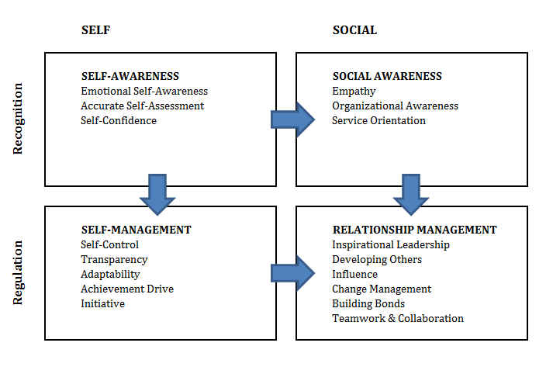

Dimensions of EI
Activity 3.3 : Measure Emotional Intelligence
Evaluate your Emotional Intelligence [on a scale of 1 to 5]:
Self Awareness
Self Management
Social Awareness
Relationship Management
➢Share your insights about EI, not the results.
15
min

Slide 72

Activity
Solution: Activity 3.3 Measure Emotional Intelligence
Evaluate your Emotional Intelligence [on a scale of 1 to 5]:
o Self Awareness 5
o Self Management 5
o Social Awareness 5
o Relationship Management 5

Slide 73
Habit – The Destination of Competency
Unconsciously incompetent
Ignorance
Consciously incompetent
Awareness
Consciously competent
Knowledge and Skill development
Unconsciously competent
Habit formation
How much time does it take to develop a habit?
Self-Awareness
Developing your self-awareness is a habit that we can all learn. This habit involves three simple steps:
Stop and notice the emotions you are feeling
Give a name to these emotions
Understand these emotions and manage them
Else, they will continue to manage you

Slide 74
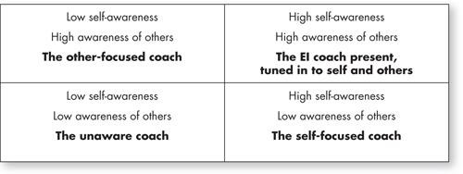
Awareness of Others
Active listening
Authentic rapport versus manipulating rapport
Empathy: the antidote to premature judgement
The Ideal EI Coach
High Awareness of Self and Others:

Slide 75
Emotional Regulation
Mindfulness
Active, open and objective attention on the present
Observing your thoughts and feelings from a distance
Labeling
Describe the emotion in just a word or two
Helps reduce the impact of emotion
Reappraisal
Ability to see situation differently
Know your Personality Type [Myers-Briggs]
16 distinctive personality types using four dimensions:
Favorite world
Extraversion (E) – Outer world
Introversion (I) – Inner world
Information Processing
Sensing (S) or Intuition (N)
Decision Making
Thinking (T) - logic and consistency
Feeling (F) - people and special circumstances
Structure
Judging (J) - get things decided
Perceiving (P) - stay open to new information and options

Slide 76
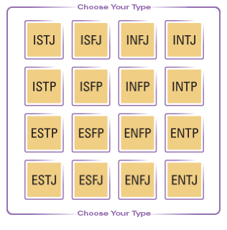
The Personality Grid
Activity 3.4 : Myers-Briggs Personality Test
Go though the 20 Questions
Evaluate your personality type
3. Share Insights if you feel like [optional]
20
min

Slide 77
Activity
Solution: Activity 3.4 : Myers-Briggs Personality Test
For questions 1 to 20 below, please circle one option – ‘a’ or ‘b’ – the one that you feel defines your behavior more closely:
1. a. expend energy, enjoy groups or b. conserve energy, enjoy one-on-one
2. a. interpret literally or b. look for meaning and possibilities
3. a. logical, thinking, questioning or b. empathetic, feeling, accommodating
4. a. organized, orderly or b. flexible, adaptable
5. a. more outgoing, think out loud or b. more reserved, think to yourself
6. a. practical, realistic, experiential or b. imaginative, innovative, theoretical
7. a. candid, straight forward, frank or b. tactful, kind, encouraging
8. a. plan, schedule or b. unplanned, spontaneous
9. a. seek many tasks, public activities, interaction with others b. seek private, solitary activities with quiet to concentrate
10. a. standard, usual, conventional or b. different, novel, unique

Slide 78
Activity
11. a. firm, tend to criticize, hold the line or b. gentle, tend to appreciate, conciliate
12. a. regulated, structured or b. easy going, “live” and “let live”
13. a. external, communicative, express yourself or b. internal, reticent, keep to yourself
14. a. focus on here-and-now or b. look to the future, global perspective, “big picture”
15. a. tough-minded, just or b. tender-hearted, merciful
16. a. preparation, plan ahead or b. go with the flow, adapt as you go
17. a. active, initiate or b. reflective, deliberate
18. a. facts, things, “what is” or b. ideas, dreams, “what could be,” philosophical
19. a. matter of fact, issue-oriented or b. sensitive, people-oriented, compassionate
20. a. control, govern or b. latitude, freedom

Slide 79
You have successfully completed –
Professional Coaching Skills
Chapter 4. Coaching Conversations – Coaching for Action

Slide 80
Learning Objectives
Coaching Models
Issue identification
Issue exploration
Action commitment
Conducting the coaching conversation
Coaching Model – Coaching for Performance

Slide 81

Activity 4.1: Peer Coaching – Personal Dilemma
We need two volunteers for this peer coaching session:
- A Coachee who has a personal dilemma
- A Coach who will help the Coachee think through the
problem and possibly find a solution
The rest of the class will observe and provide feedback after the coaching session.
15
min
Solution: Activity 4.1 Peer Coaching – Personal Dilemma
Team 1 – Speaker | Team 2 – Listener
Team 1 will deliver the speech | Team 2 Listen and may ask the question like
What more or What less you going to talk further?
This is empathy exercise but just understand , build practice for listening and don't react on them.
We need two volunteers 1 Coach & 1 Coachee
Who understand the situation better? – Coachee
Who focus to deliver the solution for the current situation ? – Coach
Source: “Quiet Leadership” by David Rock

Slide 82
Solution: Activity 4.1 Peer Coaching – Personal Dilemma
Hint
– Narrow the solution
– Give Importance (Strong | Less) | Emotion (Strong|Less)
– Internal Emotion – Focusing on one problem continuously keep asking many questions
– What owner will expect from this?
– Maintain a good rapport with coach along with SM
Coaching for Performance
Think about thinking
Listen for potential
Speak with Intent
Dance towards insight
CREATE New thinking
Follow-up
Source: “Quiet Leadership” by David Rock

Slide 83

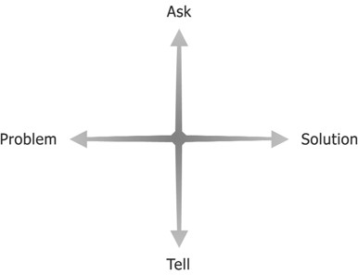



1. Think about Thinking
Let them do all the Thinking
Focus on Solutions
Remember to Stretch
Accentuate the Positive
Put Process before Content
1. Think about Thinking…

Slide 84

Listen for Potential
Coaching is about:
Enabling self-learning and growth
Unlocking potential to maximize performance
Speak with Intent
Speak with focus on maximizing improvement in thinking:
Succinct
Specific
Generous

Slide 85
4. The Dance towards Insight
Four faces of Insight
Awareness of Dilemma
Reflection
Illumination – the ‘Aha!’ moment
Motivation

Slide 86
Dance of Insight
A coaching model that helps:
Helping people develop a deeper awareness of their dilemma
Keeping people fully engaged towards making new connections
Making the ‘Aha!’ moments happen
Coaching Traps that prevent Insight
Common coaching traps that prevent progress towards insight:
Rushing the coachee
Not giving them enough personal space or thinking time
Thinking harder about the issue than the coachee himself
The one having insight is the coach
Losing focus of the goal or direction
Getting lost in the details

Slide 87
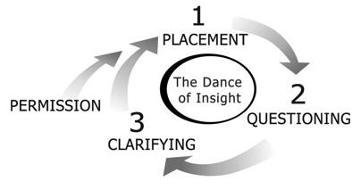
The Dance of Insight Model
Permission
Placement
Questioning
Clarifying
Step 1 : Permission
Reduces likelihood and impact of the threat response
Gives Coachee choice on the direction of coaching conversation
Demonstrates respect for the Coachee
Takes care of Status part of SCARF
Takes care of Autonomy part of SCARF
Permission should be asked when:
Starting a coaching conversation
Getting more personal than you have been so far
Coaching conversation shifts direction

Slide 88
Step 1 : Permission…
Examples:
“I get a sense you have more to say about that, could I ask you a little more on that?”
“I’d like to have a more open conversation than we’ve had before, would it be okay if I asked you some more specific questions right now?”
“Can we spend a few minutes brainstorming ideas around this?”
“I’d like to discuss your personal feelings around ... would that be okay with you?”
Step 2: Placement
Brings people to the same point in the conversation
Brings Certainty and ensures equal Status (SCARF)
Helps Coachee create clear mental map by sharing key info.:
Setting the scene
How long you’d like to speak for?
Where you’re coming from?
What your goal for the conversation is?
What you would like them to do in the conversation?
How you would like them to listen?
What’s going to happen in the conversation?
What you’re looking to achieve from the dialogue?

Slide 89
Step 2: Placement…
Example:
I’d like to have an in-depth conversation with you to get a handle on what you got out of that workshop, so that I can understand what the value was, and help you integrate the learning. I’d like to get a little detailed, would now be a good time for you?
Step 3: Questioning
Powerful Questioning is core Coaching competency:
Ask questions that make the Coachee think about Solution
Asks open-ended questions that evoke greater clarity:
Facilitate new insight, discovery or possibility
Prompt commitment to action
Asks questions that move the client forward:
Towards goals that they desire
Not backwards to problems and justifications

Slide 90
Step 4: Clarifying
Clarifying is voicing the essence of what is being said
Simplifying complex ideas allows us to make connection to other ideas easily
When you clarify, pay attention to:
What is the person trying to say?
What are they not saying?
What is the emotional context?
What is behind the words – the real feelings?
What is the essence of what they are saying?
Are they saying something that they can’t hear themselves?
Activity 4.2: Demo – Dance of Insight
We need two volunteers to practice Dance of Insight in front of the class.
Dilemma situation
I would like to have more time for strategic planning within my role, however I am always stuck in meetings, replying to emails, and people keep interrupting me. There never seems to be any time left for higher level thinking.
20
min

Slide 91

Activity 4.3: Peer Coaching – Dance of Insight
This is a peer coaching exercise to practice the Dance of insight.
For each coaching session, one person will act as Coach,
another as Coachee, and the third as observer. After the coaching session, observer will share feedback.
After each coaching session, roles will be rotated. Each session should take no more than 7 min, including observation sharing.
30
min
Coach has to follow G R O W options while discussing with Coachee:-
G – Goal, R -Reality, O-Options, W-Will
5. Create New Thinking

Slide 92
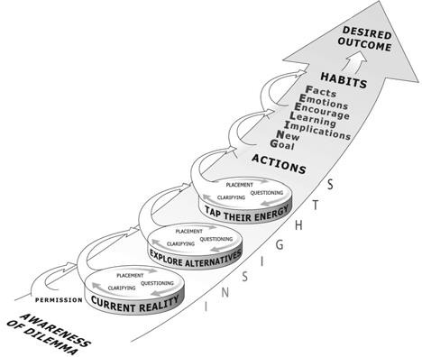
CREATE Model
The idea of CREATE model is to ‘Coach for Action’:
Current Reality
Explore Alternatives
Tap their Energy
Current Reality
Identify the landscape of a person’s thinking rather than the landscape of their issue
Avoid value judgments
Use powerful questioning:
What are your main insights about this issue up to now?
And, what else?
How important is this issue to you?
What is the real challenge here for you?
What do you feel about the thinking time you have given this so far?

Slide 93
Explore Alternatives
Help coachee take the best option
Not the easiest or the first one
Prompt people to think more
With each alternative, new mental maps are created
May give gentle suggestions or clues to other alternatives
Explore Alternatives…
Powerful questioning while exploring alternatives:
What are the possible paths we can take from here?
Do you want to explore a few different ideas?
Can you see some different angles we could look at this from ?
How can I possibly help here?
If you are saying ‘yes’ to this, what are you saying ‘no’ to?

Slide 94
Tap their Energy
Time to anchor an insight into reality:
Get specific while their energy is still flowing
Create Deadlines when people are more likely to commit
Establish feedback loop – improves odds for action
Look for a quick tangible activity linked to the insight
Tap their Energy…
Powerful questioning:
How best can I help you think through this?
Shall we focus on X and figure more details?
What specific action do you want to take first?
When do you think you might do this by?
Would it be okay to email me X when you have it ready?

Slide 95

Follow up
Facts
Emotions
Encouragement
Learning
Implications
New goal
Activity 4.4: Coaching Conversation (CREATE)
This is a peer coaching exercise using CREATE Model, where coach will help coachee make a decision, or solve a problem.
For each coaching session, one person will act as Coach, another as Coachee, and the third as observer. After the coaching session, observer will share feedback.
After each coaching session, roles will be rotated. Each session should take no more than 8-10 min, including
observation sharing.
30
min

Slide 96
You have successfully completed –
Coaching Conversations – Coaching for Action
5. Understanding Team Development

Slide 97
Learning Objectives
Working groups vs. teams
Different stages of a team
Helping a team move up the development curve
Defining and identifying high performance
The coach’s role in a self-organizing team
Identifying and Managing ‘Group Think’
Identifying and resolving conflicts
Understanding Teams

Slide 98




2/3/2017
What is a Team?
Sports Team?
People working together?
People that share the same work area?
Employees in a department?
Management group?
Definition of a Team
A team is a small number of people with complementary skills who are committed to a common purpose, performance goals and approach for which they hold themselves mutually accountable.

Slide 99
Helping a Team Choose to be a Team
Working Group
Pseudo or Potential Team
Real Team
High Performance Team
Working Group
Clear individual responsibilities, but no significant collective performance need or opportunity
No desire of common purpose, incremental performance goal or joint work product
Members may interact to help each other
Share information, best practices or perspectives
Make decisions for the entire team
Help others within own area of responsibility

Slide 100
Potential Team
A history of working together
A significant, incremental performance need
Requires more clarity about common purpose and goals
Lacks a disciplined common working approach
The practice of collective accountability is not established yet
Real Team
A group of people committed to a common purpose
Members have complementary skills
Well defined performance goals
Working processes properly understood by the team
Expected to practice collective accountability towards goals

Slide 101
Working Group vs. Real Team
Working Group | Real Team
Strong, clearly focused leader | Shared Leadership role
Individual accountability | Individual and shared accountability
The group purpose is the same as the broader organization mission | Specific Team purpose that team itself delivers
Individual work products | Collective work products
Meetings focus on status check | Meetings focus on open-ended discussions and active problem solving
Measure its effectiveness indirectly by its influence on others | Measure performance directly by assessing collective work products
High Performance Team
Been a real team for some time
Members are deeply committed to team goals
Well established processes and strong work discipline
High degree of collaboration
Significantly outperforms all reasonable expectations
Members contribute to each other’s personal growth and success

Slide 102

Team Development
Team Development Objectives
Improving knowledge and skills of team members
Improving feelings of trust and agreement
Creating a dynamic, cohesive and collaborative team culture

Slide 103

Team Development Timing
Essential during the initial stages of a project
But, truly a never-ending process
5 Stages of Team Development (Tuckman)
Forming
Storming
Norming
Performing
Adjourning

Slide 104

Vital Signs for a Team’s Stage
Themes and Identity
Enthusiasm and energy level
Event-driven history
Personal commitment
Level of collaboration
Performance results
Activity 5.1 : Team Stage Characteristics
Identify key characteristics of different team stages:
1. Observed team behavior
2. Focus areas for a Coach
Dominant Style (Coach / Trainer / Mentor / Facilitator )
Relevant Skills
20
min

Slide 105
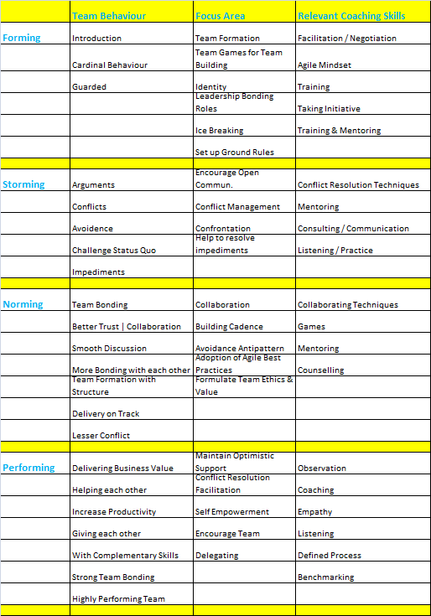
Activity

Slide 106

Team Stage – Forming
Forming Stage Characteristics
Uncertainty about roles and responsibilities
Possible lack of commitment
High curiosity and excitement
Limited information sharing
Outspoken members may assume some leadership role
Members prefer independent tasks

Slide 107

Forming Stage – Feelings and Behaviours
Members are usually excited to be part of the team
Eagerness and anxiety about the work ahead
High positive expectations about team experience
Often accompanied with some anxiety
How will I fit in with other members?
Will I be able to perform per expectations?
Forming Stage – Focus Areas
Select suitable members – Attitude and Skills
Provide clarity on role and responsibilities
Educate members about the project, team goals and process
Facilitate forming of ground rules

Slide 108

Team Stage - Storming
Storming Stage Characteristics
An uncomfortable stage for the team:
Increase in disagreements and conflicts
Competition for Control, Influence and Authority
Defensiveness may lead to impolite conversations
Blaming, back-biting, and groupism on the rise

Slide 109
Storming Stage – Feelings and Behaviours
Reality check is discomforting
Defensiveness about individual performance
A strong sense of competition may lead to frustration, anger and envy
Storming Stage – Focus Areas
Re-emphasize project purpose and team goal
Train/mentor on task-related skills
Coach on soft skills
Collaboration
Conflict management
Refine roles and responsibilities, if needed
Break larger goals down into smaller, achievable steps

Slide 110

Team Stage – Norming
Norming Stage Characteristics
Normalization of behavior and contribution
Group norms are established
Members learn to trust each other
Overall improved cooperation
Significant scope of improvement

Slide 111
Norming Stage – Feelings and Behaviours
An increased sense of overall comfort
Less reluctance to interact with others
Openness while expressing ideas
Better rapport among team members
Increased confidence about individual contribution
Conscious effort to align with others
Norming Stage – Focus Areas
Support the team
Ensure individuals don’t slip back to Storming stage
Focus on motivation and rewards
Tap the positive energy
Challenge the team towards higher performance goals

Slide 112

Team Stage - Performing
Performing Stage Characteristics
Strong team-goal orientation
Team is a well organized unit
High trust among members
Collaborative team environment
Smooth flow of information and learning opportunities
Sustained higher levels of productivity and performance

Slide 113
Performing Stage – Feelings and Behaviours
High intrinsic motivation – people take pride in their work
A "can do" attitude - visible confidence in personal and team capabilities
Unguarded participation in team discussions
Transparent work ethic
Self-initiated team-bonding opportunities
Performing Stage – Focus Areas
Empower the team in decision-making process
Ensure high trust from management
Ensure efficient requirements management for sustainable goal-
orientation
Measure and celebrate team accomplishments
Ensure team has slack time at its disposal
Learning, knowledge sharing, team-bonding activities, etc.

Slide 114
Team Stage – Adjourning
Adjourning Stage
Team completes the work and moves on
Typical occurs in Project Closing Phase

Slide 115
Adjourning Stage – Focus Areas
Ensure lessons learned are recorded
Ensure appraisals are done
Pending claims must be cleared
Detecting Team's Stage of Development

Slide 116












Sequencing of Team Stages
Forming
Storming
Norming
Performing
Adjourning
Sequencing of Team Stages…
Forming
Adjourning
Performing
Storming
Norming

Slide 117

Activity 5.2 : Identify your Team Stage
This is an individual exercise.
Fill the team assessment survey, keeping in mind the dynamics at your current team or a previous team.
Evaluate your team’s stage
Discuss your insights or concerns with the class
20
min
High Performance Agile Teams

Slide 118
Activity
Use the scale below to indicate how each statement applies to your team. It is important to evaluate the statements honestly and without over-thinking your answers.
3 = Often/Usually 2 = Sometimes 1 = Rarely or Never
————————————————————————-
____ 1. How much does humour come into day-to-day interactions within the team?
____ 2. How often are contradictory views raised by team members (including junior team members)?
____ 3.When contradictory views are raised by team members, how often are they fully discussed?
____ 4.Based on the norms of the team, how often do team members compromise in the course of usual team interactions (when not forced by circumstances)?
____ 5.To what extent can any team member provide feedback to any other team member (think about both negative and positive feedback)?
____ 6.To what extent does any team member actually provide feedback to any other team member?
____ 7. How likely would it be that a team member would discuss issues with your performance or behavior with another team member without giving feedback to you directly (triangulating)?
____ 8. To what extent do you as an individual get support from your team on your personal career goals (such as learning a new skill from a team member)?

Slide 119
Activity
____ 9. How likely would you be to ask team members for help if it required your admission that you were struggling with a work issue?
____ 10. How likely would you be to share personal information with the team that made you feel vulnerable?
____ 11. To what extent is the team likely to bring into team discussions an issue that may create conflict or disagreement within the team?
____ 12. How likely or willing are you to bring into a team discussion an issue that is likely to have many different conflicting points of view?
____ 13.If you bring an item into a team discussion that is likely to have many different conflicting points of view, how often does the team reach a consensus that takes into consideration all points of view and feels workable to you?
____ 14.Can you identify an instance in the past few work days when you felt a sense of warmth or inclusion within the context of your team?
____ 15.How much does the team make you feel accountable for your work?
Calculate Your Score : _____ / 45
Higher Score indicates more performing team

Slide 120







A High Performance Agile Team
Agile teams aim to be high performance teams:
Propelled by shared purpose
Shared leadership
Free from Command and Control culture
High Trust
High degree of collaboration
Continuously seeking to improve
Self-managing
Activity 5.3 : The House of High Performance Culture
This is a group exercise.
Create a house of High Performance Team Culture using the key characteristics of high performing Agile teams.
20
min

Slide 121
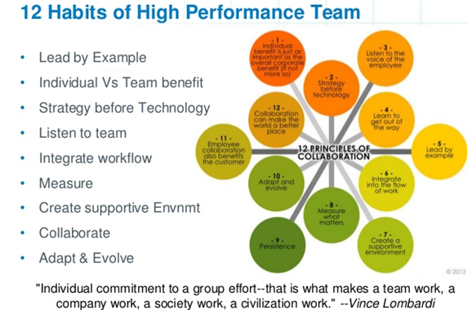
Activity
A High Performance Agile Team
Agile teams aim to be high performance teams:
Propelled by shared purpose
Shared leadership - 4
Free from Command and Control culture
High Trust - 1
High degree of collaboration
Continuously seeking to improve - 2
Self-managing - 3

Slide 122
Collaboration for Agile Teams
Characteristics of Collaborative Teams
The characteristics of high collaboration and, thus, high performance (adapted from Tabaka 2006):
They are self-organizing rather than role- or title-based.
They are empowered to make decisions.
They truly believe that as a team they can solve any problem.
They are committed to team success vs. success at any cost.
The team owns its decisions and commitments.
They are consensus-driven, with full divergence and then
convergence.
And they live in a world of constant constructive disagreement.

Slide 123










Collaboration demands Behavior Changes
 | From | To
 | Individual Accountability | Joint Accountability in addition to Individual accountability
 | Rely on managerial control | Encourage people to manage their own work
 | Divide work into tasks and assign to people | Expect everyone to plan work together and pull tasks
 | Build Functional Excellence by narrowing set of tasks done by individual | In an effort to finish work faster, encourage people to learn and volunteer for work outside their specialization
 | Maximize individual productivity - A fair day’s pay for fair day’s work | Support personal growth that expands as well as exploits individual capabilities
Collaboration Principles
Help promote high degree of Collaboration
With strong Result Orientation
Alignment
Empowerment
Engagement
Transparency
Accountability

Slide 124





enBridge | Confidential
Activity 5.4: Collaboration principles vs. key Agile practices
This is a group exercise.
For each of the Collaboration principle, identify two to five key agile practices that are aligned to that principle.
20
min
Five Dysfunctions of a Team
Inattention to Results
Avoidance of Accountability
Lack of Commitment Fear of Conflict
Absence of Trust
Source: “The Five Dysfunctions of a Team” by Patrick Lencioni:

Slide 125
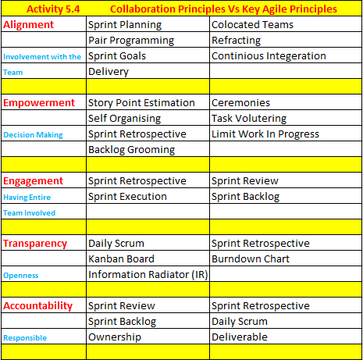
Activity

Slide 126
Activity 5.5 : Assessment - Dysfunctions of a Team
This is an individual exercise.
Please complete the assessment on behalf of your team.
[Optional] Please share your team’s dysfunctions, if any.
3. Please share any new insights gathered from this activity.
20
min
Groupthink

Slide 127
Activity
Activity 5.5 – Dysfunctional Team Assessment
Instructions: Use the scale below to indicate how each statement applies to your team. It is important to evaluate the statements honestly and without over-thinking your answers.
3 = Usually | 2 = Sometimes | 1 = Rarely
_____ 1. Team members are passionate and unguarded in their discussion of issues.
_____ 2. Team members call out one another’s deficiencies or unproductive behaviors.
_____ 3. Team members know what their peers are working on and how they contribute to the collective good of the Team.
_____ 4. Team members quickly and genuinely apologize to one another when they say or do something inappropriate or possibly damaging to the Team.
_____ 5. Team members willingly make sacrifices in their areas of expertise for the good of the Team.
_____ 6. Team members openly admit their weaknesses and mistakes.
_____ 7. Team meetings are compelling, and not boring.
_____ 8. Team members leave meetings confident that their peers are completely committed to the decisions that were agreed on, even if there was initial disagreement.
_____ 9. Morale is significantly affected by the failure to achieve Team goals.

Slide 128
Activity
_____ 10. During Team meetings, the most important – and difficult – issues are put on the table to be resolved.
_____ 11. Team members are deeply concerned about the prospect of letting down their peers.
_____ 12. Team members know about one another’s personal lives and are comfortable discussing them.
_____ 13. Team members end discussions with clear and specific resolutions and calls to action.
_____ 14. Team members challenge one another about their plans and approaches.
_____ 15. Team members are slow to seek credit for their own contributions, but quick to point out those of others.
Calculate Your Score : _____ / 45
Higher Score indicates more performing team

Slide 129


What is Groupthink?
A phenomenon that occurs when the desire for harmony or conformity
in the group results in
an irrational or dysfunctional decision-making outcome.
Symptoms of Groupthink
Illusion of invulnerability – Excessive optimism leading to extreme risks
Collective rationalization – Discounting warnings and assumptions
Belief in inherent morality – Belief in the rightness of their cause
Stereotyped views of out-groups – Avoidance/ignorance of conflict
Direct pressure on dissenters
Self-censorship – of deviations from perceived group consensus
Illusion of unanimity – Majority view and judgments are assumed to be unanimous.
Self-appointed ‘mindguards’ – Members protect the group and the leader from information that is contradictory to the group’s cohesiveness, view, and/or decisions

Slide 130
Remedies for Groupthink
Assign the role of critical evaluator to each member
Avoid stating preferences and expectations at the outset
Invite outside experts to group meetings
Outside experts should be encouraged to challenge views of members
Assign one member the role of devil's advocate
to question assumptions and plans
Set aside a sizeable block of time to survey warning signals from rivals
Group should construct alternative scenarios
Handling Conflicts

Slide 131





Handling Conflicts : Agile Coach Responsibilities
Skillfully determines the severity of conflict
Mindfully decides whether to intervene and how
Generously teaches teams how to navigate it
Courageously refuses to settle for a team that tries to hide or avoid it
Five Levels of Conflict (Speed Leas Framework)
Level 5:
World War
Level 4: Crusade
Level 3: Contest
Level 2: Disagreement
Level 1: Problem to Solve

Slide 132
Level 1: Problem to Solve
Just a “difference of opinion”:
Conflicting goals or values may exist
Members feel anxious about the conflict in the air
Team remains focused on logical problem-solving
Language is factual and logical
Information flows freely, and collaboration is alive
Team members seem optimistic, moving through the conflict
Level 2: Disagreement
Personal emotions are visible in the conflict:
Self-protection is as important as solving the problem
Members may talk offline with others to test strategies or seek advice and support
Nastiness gets a sugarcoating but still comes across as bitter
Language reflects emotions and generalizations
Defensiveness may constrain smooth flow of information
Facts begin to play second fiddle to interpretations

Slide 133
Level 3: Contest
A sense of ‘groupism’ begins to surface:
Multiple issues may cluster into larger issues or “cause”
Misunderstandings and power politics begin to arise
People begin to align themselves with one side or the other
Emotions become tools used to “win” supporters for one’s
position
Language full of overgeneralizations
People may not be ready to move beyond blaming
Level 4: Crusade
Group boundaries are very clear now:
Factions become entrenched
The overall attitude is righteous and punitive
“People on the ‘other side’ will not change!”
Members believe the solution is to remove others from the team or get removed from the team themselves
Language is ideological

Slide 134
Level 5: World War
Extreme level of group rivalry:
‘Destroy’ the other
“It’s not enough that we win; others must lose!”
Difficult to have constructive outcome
Major team restructuring may be required
Responding to Conflict
Do Nothing
Wait for team to resolve
Analyze and
Respond
Take lead in resolution: Least Preferred
Conflict
Use Structure
Navigate around the Conflict - Better
Reveal
Reveal the conflict management model to team

Slide 135
You have successfully completed –
Understanding Team Development
6. Setting up the Team Environment

Slide 136
Learning Objectives
Helping teams to know themselves
Helping teams create their culture & vision
Creating team agreements & ground rules
Setting up the work environment
Accommodating the team’s geographical relationship
Creating a team kickoff/startup agenda
Learning About the Team

Slide 137








Learning About the Team
Learning about each other
Behaviour, attitude, beliefs
Skills and expertise
Work background
Cultural background
Learning about the team context
Management’s vision for the Team
Key goals and expectations
Roles and reporting hierarchy
Helping Teams Know Themselves
Help members learn about others so they can better collaborate in meeting team goals:
Stranded on an island
Finish the sentence
Journey Line
Market of Skills
Constellation
Values

Slide 138
Activity 6.0 : Finish the Sentence
Finish the sentence with the first thought that comes to mind:
1. My favourite colour is …………………………............... 2. My favourite food is …………………………………….......
3. My favourite movie is ……………………………………….
4. My favourite passtime is ……………………………….... 5. I like people who ……………………………………………… 6. I feel trust is ……………………………………………………… 7.
8.
Personally, I would define success as ………………... I would define happiness as ………………………………..
10
min
White, Biryani, Sivaji , Surfing Net, Likes Me | are frank, trustworthy | Important
Accomplishment of an aim or purpose, Being Happy
Journey Line
Graph your professional journey:
Start as far back as you want
Draw the key events – ups and downs
Present a summary to the team

Slide 139
Create a Shared Vision
Multi-Level Goals
What’s in it for me?
What is in for us as a team?
What is in for my company?
What is in for the world?

Slide 140


What’s in it for ME?
When this project is over, I want to be able to say I have expert level skills in Hadoop.
What’s in it for US, the Team?
We want to create a product using Agile methods that delivers value to the customer on a regular basis.

Slide 141






What is in for My Company?
We are developing new market segment for online training that will help the company meet its target of revenue growth by more than 25%.
What is in for the World?
Our online training product will help working professionals enhance their knowledge and skills in a cost- effective manner in the comfort of their home.

Slide 142
Example: Creating Shared Vision
Individual exercise:
What’s in it for me?
What is in for us as team?
What is in for my company?
What is in for the world?
Compile and make shared vision
Creating Team Agreements & Ground Rules

Slide 143
Team Norms
Shared Values
Keep it simple
Don’t struggle for more than 30 minutes – ask for help
Rules for working together
No meals on the desk, snacks are fine
No personal chats during team meeting
Logistics
Core hours
Meeting times
Leaves
Being together in conflicts
Setting up the work environment

Slide 144
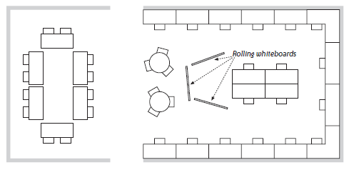
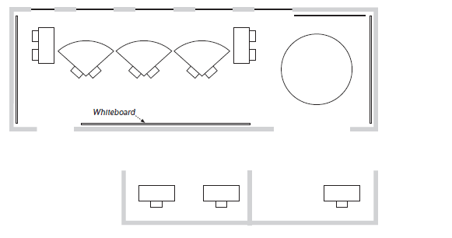
Sit Together
Quick access to other members
Face to face interaction enhances communication
Decision making, problem solving, and knowledge sharing
Sample Workspaces

Slide 145
Different Team Settings
The Ideal Team Setting
Co-located
Ongoing/ Long-term
Single Organization
Same Culture

Slide 146
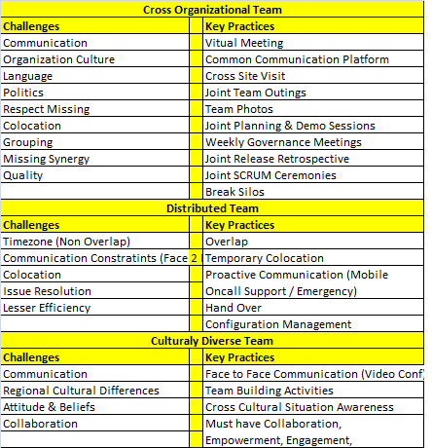
Activity
Solution: Activity 6.1 Discuss Challenging Team Settings

Slide 147
Activity 6.1 : Discuss Challenging Team Settings
This is a group exercise.
1. Discuss and identify the key challenges specific to the following types of team settings:
– Virtual or Distributed teams
Temporary teams
Cross-Organization teams
Culturally Diverse teams
2. Discuss three to five key practices that can help mitigate the challenges/risks associated with these team settings.
20
min
Accommodating Team’s Geographical Relationship
Why have Distributed Teams at all?
Availability of resources
Availability of specialized skills
Cost-effectiveness
Support for different time-zones or markets

Slide 148
Challenges with Distributed Agile Teams
Communication
Limited or no F2F communication
Collaboration
Difficult to have the entire team together
Transparency
Work assignment and status is not visible across locations
Shared Learning
Difficult to share knowledge across locations
One Team Feeling
Common to have development of silos – We vs. Them
Distribution Strategy
Collaborating collocated teams
Multiple Deliberately Distributed Teams

Slide 149

Collaborating Collocated Teams
Preferred option
Simplifies day to day work for most team members
Need enough people to establish team at each location
Each collocated teams must be cross-functional
May have resource/skill availability constraints
Team 1
Team 2
Location A
Location B
Deliberately Distributed Teams
May be cost effective due to localized special skills
Creates communication and co-ordination burden
Increases Transparency
Team 1
Team 1
Team 2
Team 2
Location A
Location B

Slide 150
Managing Distributed Teams
Favour live communication over email and documentation
Create opportunities to bring the team together
Initial co-location
Seeding Visits
Contact Visits
Traveling Ambassadors
Adding Some Process and Structure
Agree on one common language
Clarify tasks and processes, not just goals and roles
Use of collaboration tools like Jira, Wiki, Sharepoint, etc.
Insist on whole team presence in team meetings
Understanding Cultural Differences
Power Distance Index (PDI)
Individualism (IND)
Achievement Orientation (ACH)
Uncertainty Avoidance Index (UAI)
Long Term Orientation (LTO)

Slide 151

Activity 6.2 : Ground Rules for a Distributed Team
This is a group activity.
You are a new distributed Scrum team with members in two different locations, with time zone difference of 4 hours. You have been brought together for the initial kick off meeting.
– Based on your previous experience, make a list of 5 to 8 key
ground rules that should help the team members work effectively with each other and be able to produce working product at the end of each sprint.
– Share your team’s ground rules with other groups
20
min
Solution: Activity 6.2 Ground Rules for a Distributed Team
-> Time Overlap for Europe & India Project
India – 2 Pm-6 Pm | Europe 10Am – 2 Pm
-> Meetings
Whole team presence during overlap timings
3 Pm IST , 11 Am Europe Timings
Dollar Jar (Fine for late) INR 50 | Euro 1

Slide 152
Activity 6.3 : Team Environment Discussion
This is a group activity.
20
min
You have successfully completed –
Setting up the Team Development

Slide 153
7. Review and Assessment of Agile
Frameworks
Learning Objectives
Agile values and key practices
Teaching / Selling Agile
Evaluating Agile Frameworks

Slide 154

Why and How of Agile?
Need for Agility
Value-driven delivery
o Better aligned with customer needs
Faster time to market
Better transparency
Responsiveness to change
Self-managing teams
Sustainable pace of development
Reduced process waste

Slide 155
Agile Manifesto – The Values
We are uncovering better ways of developing software by doing it and helping others do it. Through this work we have come to value:
Individuals and interactions over processes and tools
Working software over comprehensive documentation
Customer collaboration over contract negotiation
Responding to change over following a plan
This implies, while there is a value in the items on the right, we value the items on the left more.
Key Agile Practices
Visualize your work
Limit work in progress
Defer commitment – Match demand with capability
Progressive Elaboration
Adaptive Planning
Emergent Design
Faster Feedback Cycle
Collaboration
Release early and often
Continuous Improvement

Slide 156

Activity 7.1 : Evaluation of an Agile Framework
This is a group exercise.
1. Based on your personal experience, discuss the positives and the challenges with an Agile framework
of your choice.
Prepare a chart, listing top 3 to 5 most important positives and 3 to 5 key challenges.
Share your analysis with the class.
20
min

Slide 157
Activity
Solution: Activity 7.1 Evaluation of Agile Frameworks
SAFe Positive Challenges
Positive | Challenges
Proven, well documented, and flexible framework; lean underpinnings People-centric view on agile delivery with clear roles, artifacts, events Holistic, 3-tier view of value stream including Portfolio level Strong Code quality (Agile Engineering and DevOps) focus Established scaling framework in Marketplace Constant refinement of SAFe knowledge base | Prescriptive Heavy Weight Certification Centric

Slide 158
Activity
Solution: Activity 7.1 Evaluation of Agile Frameworks
SAFe Positive Challenges
Positive | Challenges
Engagement across layers Clear roles Scalability Value Driven Program Board ART Themes -Capabilities – Feature – Stories Applicable to Larger Teams Feedback at value stream level (Solution Demo) Rapid Development Feature Roles Good Cadence | Cannot be applied to smaller teams Relatively Heavy (Multiple Roles) Costly Ceremonies Cadence & Synchronization is tedious to maintain Mandatory Architecture Runway is tedious (Requires at least PI Planning) Huge Collaboration Huge Upfront Cost

Slide 159
Activity
Scrum Positive Challenges
Positive | Challenges
Inspect | Adapt | Transparency Fail fast | Faster feedback Collective ownership Continuous Improvement Self Organized team Collaboration Engagement Self Delivery Teams Well defined roles / ceremonies Early Feedback Accountability Shared risk High Quality Excellent Productivity | Skill set for co-locations Delivery commitment of every two weeks Not having deliverable after every Sprint Larger Team Mind-set Change Ad-hoc requirements within the Sprint Resource Criticality Inefficient resource utilization (Testers are free at the beginning and over busy at the end) Adaptability & Sustainability Time-box collaboration Team level limit (Only for smaller teams) Cross functional team structure Framing Agile centric metrics Some times story point estimation

Slide 160
Activity
Kanban Positive Challenges
Positive | Challenges
Supports dynamic requirements prioritization No time-box value Lead & cycle time delivery can be calculated Visualize blockage through the cumulative flow diagram | workflow Limit Work In Progress Manage Workflow , Pull Faster Throughput No Team Limit, Allows Specialist Well defined Roles Improves [Kaizen] Process Expose Bottleneck | Knowledge work industry (Green –New Brown-Existing project) Arriving optimum WIP limit Lesser Collaboration No Control limit on changes Higher degree of variation Starvation New Product Development Limited Estimation / Commitment
Scrum | Kanban
Quicker Value Realization Empower & Motivated Teams Customer Satisfaction Good Quality | Better Visualization Faster Throughput, Higher Cyclic Team No Team limit, Allows Specialist Roles

Slide 161
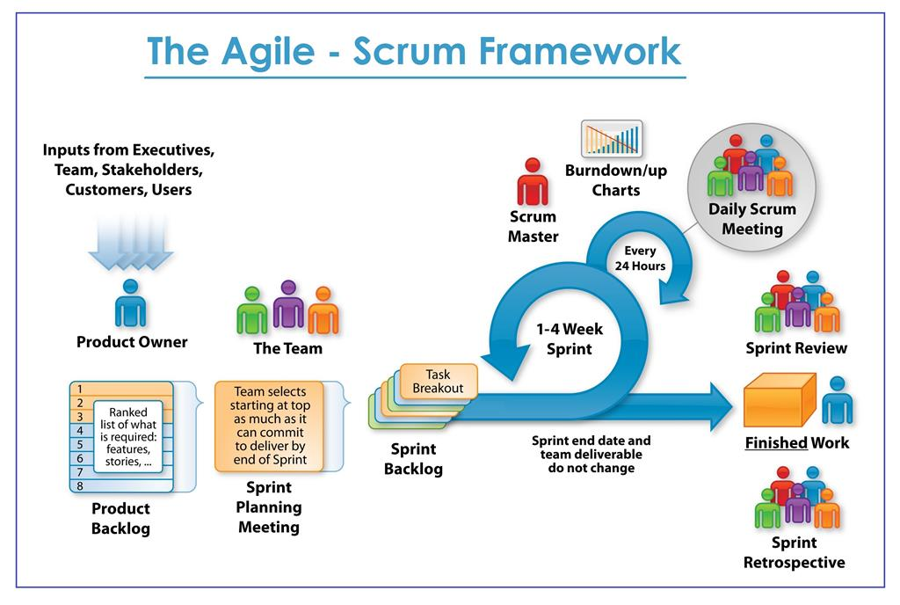
Scrum –
Agile Framework in Focus

Slide 162





Characteristics
The most popular ‘Agile Process’ for software development
A project management/execution process framework
Well suited for projects that require Empirical process control
Focuses on self-organizing teams
Requirements are captured in a prioritized list (Product Backlog)
Product progresses in a series of month-long “sprints”
No specific engineering practices prescribed
Scrum
24 hours
Sprint 30 Days
Sprint goal
Return
RCaentcuerln GCoifutpwonrasp
GiCftawnrcaepl
Product backlog
Sprint backlog
Potentially shippable product increment
Coupons

Slide 163
Scrum Framework
Roles
Ceremonies
Artifacts
Product Owner
Sprint Planning
Product Backlog
Scrum Master
Daily Scrum
Sprint Backlog
Development Team
Sprint Review
Product Increment
Retrospective
Activity 7.2 : Elevated Pitch for Agile – Demo
We need volunteers who will present the following topics to the entire class (timeboxed to 5 min):
1. Why transition to Agile?
2. Essence of Scrum
3. Essence of Kanban
Class provides feedback after the presentation.
[Optional] Make videos of the presentation, for self review.
20
min

Slide 164
Activity
Solution: Activity 7.2 Elevated Pitch for Agile - Demo
1. Why transition to Agile?
Agile creates wonders with every life nowadays. more easy adaption , global model, good imagination clients thoughts get reflected immediately, provides good leadership level for organization to support customers, as an entrepreneurial customers, it shows the value of an organization at higher level
2. Essence of Scrum
– Quicker Value Realization
– Empower & Motivated Teams
– Customer Satisfaction
– Quality
3. Essence of Kanban Class provides feedback after the presentation.
– Better Visualization
– Faster Throughput, Higher Cyclic Team
– No Team limit, Allows Specialist Roles

Slide 165

Activity 7.3 : Elevated Pitch for Agile
Form groups of 2-3 persons. Everyone in the group prepares elevated pitch for Agile, Scrum or Kanban and presents within their group – timeboxed to 5 minutes max.
The group provides feedback after each presentation.
[Optional] Make videos of the presentation, for self review.
20
min
You have successfully completed –
Review & Assessment of Agile Frameworks

Slide 166
Chapter 8.
Mentoring Agile Roles & Transitions
Learning Objectives
Mentoring and coaching the roles in Agile
Mentoring and coaching the key transitions for Agile roles
Identifying and handling resistance from individuals
Review of Agile Coaching

Slide 167

Resistance to Agile Transition
Activity 8.1 : The Flight of Agile Transition
Thinking about your recent or current agile transformation, identify as a group (up to three items in each section):
Where do we want to go, the ideal destination?
Who are the stakeholders (passengers)?
Who is flying the plane (pilot)?
What gives us power (engine)?
What gives us the lift/support (wings)?
What helps us control the path (tail)?
What are the obstacles (wind)?
20
min

Slide 168
Activity
Solution: Activity 8.1 : The Flight of Agile Transition
Thinking about your recent or current agile transformation, identify as a group (up to three items in each section): Draw the plane and create the parts :- 1.Where do we want to go, the ideal destination? Business Value 2.Who are the stakeholders (passengers)? Scrum Team | Customer | Leadership 3.Who is flying the plane (pilot)? Product Owner 4.What gives us power (engine)? Development Team 5.What gives us the lift/support (wings)? Scrum Master 6.What helps us control the path (tail)? Metrics 7.What are the obstacles (wind)? Lack of knowledge | Old roles and process
Solution: Activity 8.2 : Resistance to Agile Transition
Status Certainty Autonomy Relatedness Fairness
Team
New Process – Certainty
More Transparency & Accountability -Autonomy
Knowledge Sharing – Autonomy
Colocation – Autonomy | Certainty
TL/TM
Dynamic Planning – Certainty
Roles Change – Status
Self Managing Teams – Autonomy
Customer Collaboration – Autonomy
Senior Management
Empowerment – Autonomy
Transparency to Customer – Autonomy
Variability in Productivity – Certainty
Customer
Time Availability – Autonomy
Contract Model Changes – Certainty

Slide 169

Transition is a Long Change Process
Usually, the bigger the change, the stronger the resistance!
Activity 8.2 : Resistance to Agile Transition
This is a class exercise.
Agile transition brings changes in roles, responsibilities and team
structure that people may not feel open to.
From your personal experience, WHO typically resists WHAT kind of change during Agile transition process?
– Write each discomforting change on a separate sticky note and post it on the board.
Map the resistance stickies to different SCARF categories.
20
min

Slide 170

Coaching Agile Roles
Revisiting Agile Coach Roles
Coaching
Mentoring
Teaching
Teaching: Share knowledge to help them understand agile values, principles, and their role
Mentoring: Show and help them practice how work gets done in an agile process
Coaching: Help them find solution to their problems on their own, in line with Agile values and principles

Slide 171
Coaching Agile Roles – Focus Areas
Train them on Agile Framework
Develop Agile Mindset
Develop Lean Mindset
Develop T-Skilled Professionals
Ground Work for One-On-One Coaching
Guarantee Safety
Partner with Manager
Create a positive regard
Meet them a half-step ahead

Slide 172
Activity
Solution: Activity 8.3 Agile Roles Do’s & Don'ts
Scrum Master Do’s & Don’ts
Do’s | Don'ts
Building Team Capability and Predictability Facilitation Servant Leadership Process Champion Remove Impediments Protects the team Coach the team as well “SM become Coach” Lead by example Effective Communication Active Listening Keep up the balance Set realistic pace Open to learn Accept Feedback | Manage the Team – Performance Review | Authority Allocation of Work Planning of work Taking Decision

Slide 173
Activity
Solution: Activity 8.3 Agile Roles Do’s & Don'ts
Development Team Do’s & Don‘ts
Do’s | Don'ts
Collaboration Knowledge Sharing Accountable Transparency Common Team Goal | Non Collaborative behaviour (Groupism | Selfishness) Wait for Orders Resistance to Agile Mind-set / Productivity Depend on SM alone Be the Change

Slide 174
Activity
Product Owner Do’s & Don t’s
Do’s | Don'ts
Product Vision Product Backlog Grooming Prioritization Writing Stories Schedule Demo Involving in Ceremonies Involving with customers Attending Sprint Demo’s Product Roadmap Release Dates (Pre | Postpone) | Should interact directly with the team Not changing requirement in middle of the sprint in team meeting Should not give story points to strategy Not involve in Story Point estimation Should not compare multiple Scrum Team

Slide 175

Activity 8.3 : Agile Roles - Do’s and Don’t’s
This is an group exercise.
For each Scrum Role, discuss and create a list of “Do’s and Dont’s” – limit to 3-4 max
Discuss your final sheet with the entire class
20
min
Coaching Product Owner – Understanding Role
Business Value Driver
Vision keeper
Daily Decision maker
Heat shield
One ultimately responsible

Slide 176
Coaching Product Owner – Key Tasks
Mentor Product Owners understand their priorities:
Be the vision keeper – in sync with sponsor
Move from schedule-driven to business-value-driven planning
Cultivate Business value driven thinking in all interactions
Maintain a DEEP product backlog
Match demand with capability
Learn to trust the team
Avoid micro-management
Hold the team for their commitments
Coaching Scrum Master – Understanding Role
Caretaker of the agile process
Servant leader
Facilitator
Progress tracker towards the goal
Bulldozer for impediments
Guardian of quality

Slide 177
Coaching Scrum Master – Key Tasks
Coach Scrum Master understand their priorities:
Facilitator, not decision maker
Self-managing teams
Planning work
Pulling work
Tracking work
Getting work done
Sustainable pace of development
Activity 8.4 : Coaching Agile Roles
This is a class discussion exercise.
1. Participants share difficult role specific situations from their real life experience that an Agile Coach may have
to deal with.
2. The class discusses possible approach to deal with that situation, highlighting specific questions that may help.
20
min

Slide 178
Activity
Solution: Activity 8.4 Coaching Agile Roles
Resolve First
What makes you fell really?
What happened really?
What’s going on?
What else made you feel?
What possibility do you go with?

Slide 179
You have successfully completed –
Mentoring Agile Roles & Transitions
Activity : Steps to being a Better Agile Coach
This is an individual exercise.
1. Try to recollect the topics discussed over the past three
days of training.
Identify three key learnings that appealed the most to
you.
Identify one to two most priority action items that you can commit to towards being a better agile coach.
4. [Optional] Share your list with the class (1-2 min).
20
min

Slide 180

References – Books
“Coaching Agile Teams” - by Lyssa Adkins
“Quiet Leadership” - by David Rock
The Wisdom of Team – by Jon R Katzenbach
Art of Agile Development - by James Shore and Shane Warden
“Emotional Intelligence Coaching” by Steve Neale; Lisa Spencer-Arnell; Liz Wilson
“Applied EI” (2006) by Sparrow and Knight
References – Websites
https://inteamwetrust.com
http://www.slideshare.net/alexeypikulev/getting-started- with-the-team-trust-canvas
http://hrweb.mit.edu/learning-development/learning-
topics/teams/articles/stages-development
www.agilecoachinginstitute.com/resources/competency- model/
www.coachfederation.org/
https://howardgardner.com/multiple-intelligences/

Slide 181
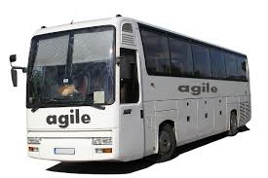

BE AGILE
STAY AGILE
THINK AGILE

